Slide 1


ANNOUNCEMENTS AND REMINDERS:
* ALL PARTICIPANTS ARE AUTOMATICALLY MUTED.
* please share your QUESTIONS FOR SPEAKERS IN THE CHAT BOX.
* THIS MEETING WILL BE RECORDED & AVAILABLE AT: https://www.firstup.org/sepecc/
SEPECC Meeting
Tuesday, January 28, 2025
Agenda:
12:30 Welcome
12:35 Guest Legislator: Rep. Fitzpatrick’s Leg. Asst, Clare Dentner
12:45 Federal, State & Local Budget/Policy Updates
12:55 ECE Advocacy in Action
1:20 OCDEL, DHS & ELRC Announcements
1:40 Special Presentation: Staffing Challenges & Possible Supports
2:00 Community Partner Resources
2:10 Public Policy Partners: Racial Equity ECE Provider Council
2:20 Wrap Up
Meeting will begin at 12:30pm

Slide 2
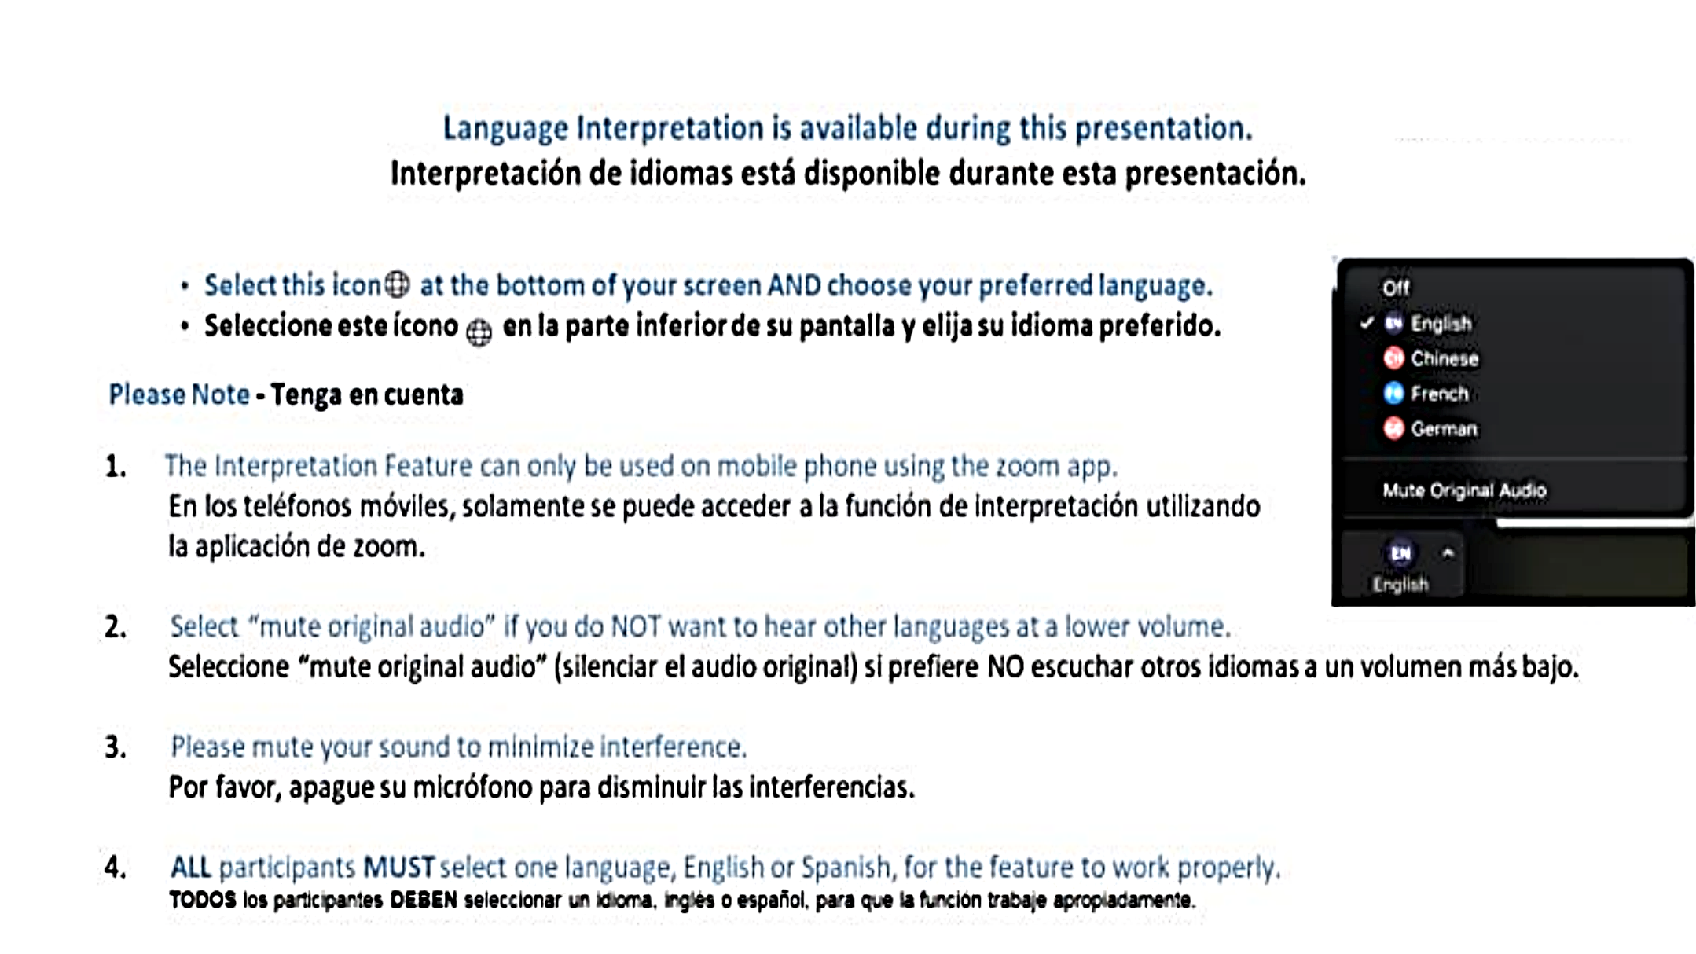

Slide 3

Pqas Hours for SEPECC

Slide 4
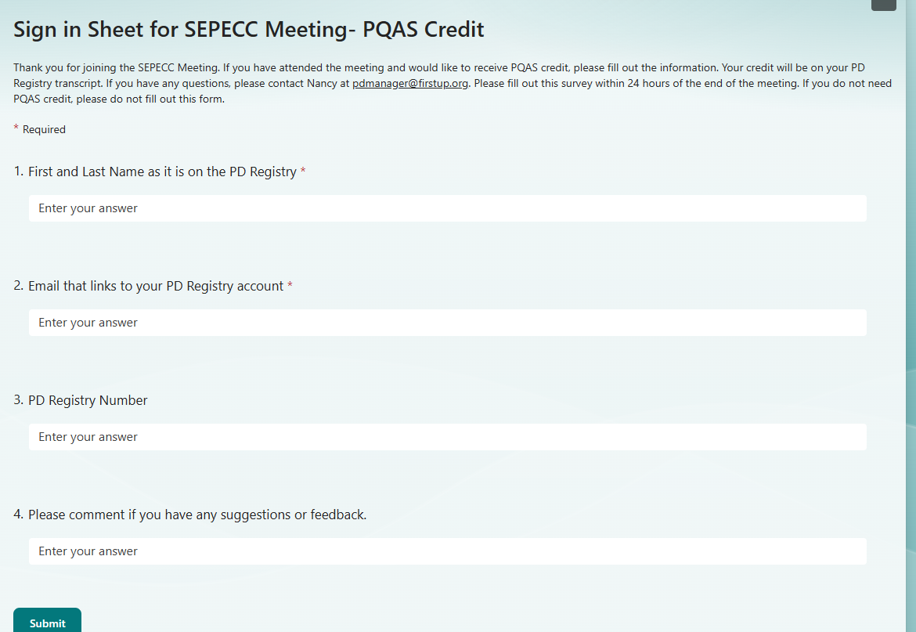

Pqas Hours for SEPECC
Please complete sign in
within 24 hours of the meeting end if you would like to receive PQAS credit.
Here is the link and QR code:
https://forms.office.com/r/RfzSg97k7j

Slide 5
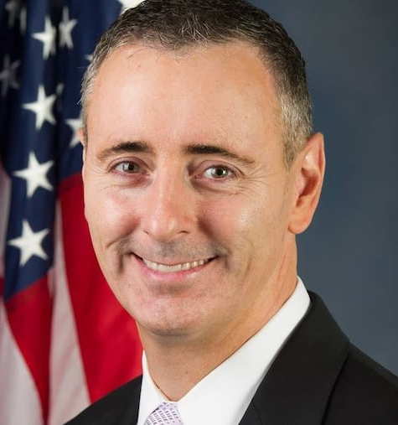
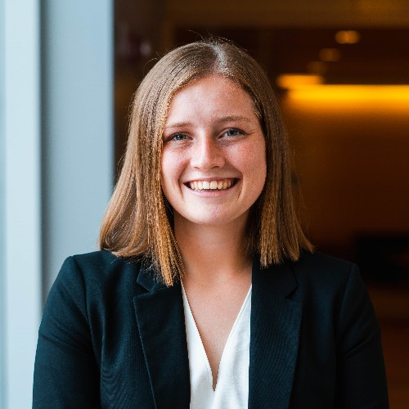
Guest Legislator:
Congressman Brian Fitzpatrick’s
Legislative Assistant,
Clare Dentner
First Congressional District of Pennsylvania
(Bucks county & Montgomery county)
Tina Haney, Middle Bucks Institute of Technology

Slide 6




Mary Graham,
Children’s Village
Budget & Policy updates
- Federal -
Urge your Members of Congress to Protect and Expand the Child Care & Dependent Tax Credit (CDCTC)!
https://www.ffyf.org/actions/2025/email/

Slide 7

Tyrone Scott,
First Up
Budget & Policy updates
- State & Local -
Support for ECE
Senate
House
Chambers

Slide 8


NEW Committee Assignments
SENATE
Chairs & Member Committee Assignments
https://www.legis.state.pa.us/cfdocs/CteeInfo/StandingCommittees.cfm?CteeBody=S
HOUSE
Chairs & Member Committee Assignments
https://www.legis.state.pa.us/cfdocs/CteeInfo/StandingCommittees.cfm?CteeBody=H

Slide 9
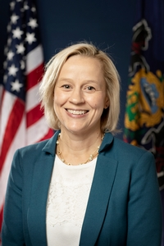
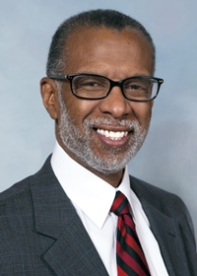
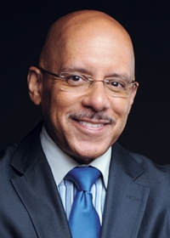
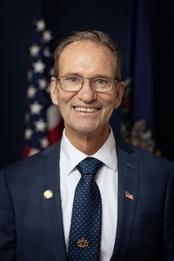
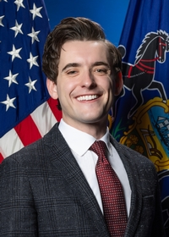
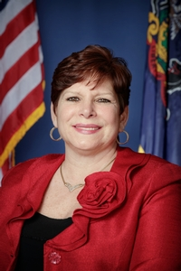
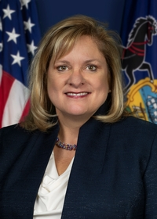
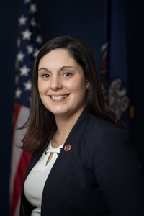
SENATE LEADERS - SEPA
Labor & Industry
Minority Chair
Aging & Youth
Minority chair
Health & Human Services
Minority chair
Appropriations
Minority chair
Health & Human Services
Appropriations
Sen. Vincent Hughes
District 7
Montgomery & Philadelphia
Sen. John I. Kane
District 9
Chester & Delaware
Sen. Maria Collett
District 12
Montgomery
Sen. Art Haywood
District 4
Montgomery & Philadelphia
Minority Whip
Aging & Youth
Appropriations
Health & Human Services
Appropriations
Appropriations
Sen. Joe Picozzi
District 5
Philadelphia
Sen. Amanda Cappelletti
District 17
Delaware & Montgomery
Sen. Christine Tartaglione
District 2
Philadelphia
Sen. Tracy Pennycuick
District 24
Montgomery

Slide 10
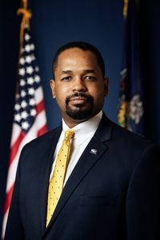
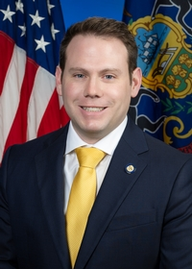
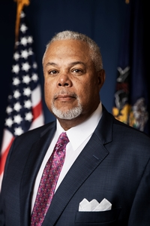
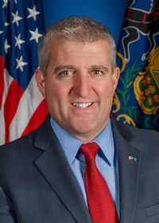
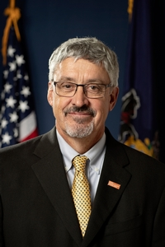
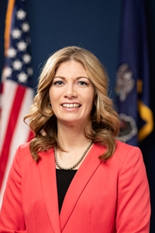
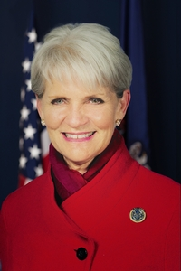
SENATE LEADERS - SEPA
Health & Human Services
Appropriations
Education
Health & Human Services
Education
Appropriations
Sen. Sharif Street
District 3
Philadelphia
Sen. Jarrett Coleman
District 16
part of Bucks
Sen. Anthony Williams
District 8
Delaware & Philadelphia
Sen. Frank Farry
District 6
Bucks
Aging & Youth
Appropriations
Education
Education
Sen. Katie Muth
District 44
Berks/Chester/Montgomery
Sen. Carolyn T. Comitta
District 19
Chester
Sen. Timothy Kearney
District 26
Delaware(part)

Slide 11
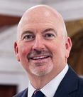
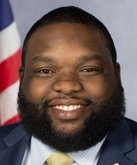
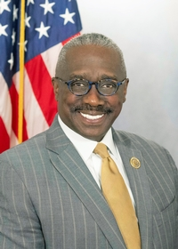
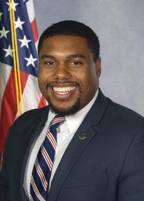
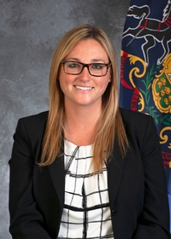
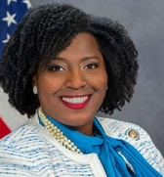
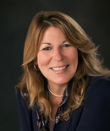
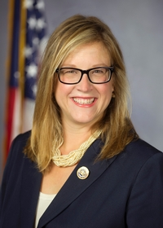
HOUSE LEADERS - SEPA
Labor & Industry
Majority chair
House Majority Leader
Appropriations
Majority chair
Human Services
Majority chair
Rep. Matthew Bradford
District 70
Montgomery
Rep. Jordan Harris
District 186
Philadelphia
Rep. Dan K. Williams
District 74
Chester
Rep. Jason Dawkins
District 179
Philadelphia
Republican Caucus Chair
House Speaker
Democrat Caucus Secretary
Majority Caucus Administrator
Rep. Martina White
District 170
Philadelphia
Rep. Joanna McClinton
District 191
Delaware & Philadelphia
Rep. Tina Davis
District 141
Bucks
Rep. Leanne Krueger
District 161
Delaware

Slide 12
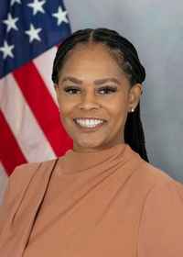
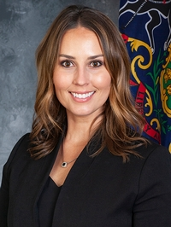
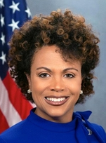
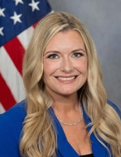
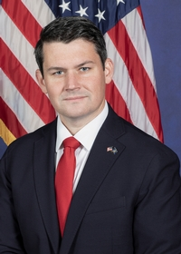
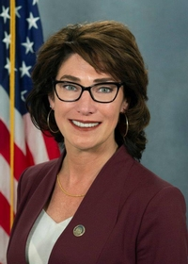
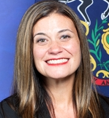
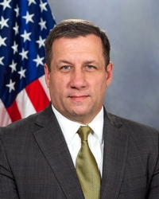
HOUSE LEADERS - SEPA
Appropriations
Children & Youth
Philadelphia House Delegation Chair
Human Services
Children & Youth
Human Services
Education
Rep. Morgan Cephas
District 192
Philadelphia
Rep. Shelby Labs
District 143
Bucks
Rep. Gina Curry
District 164
Delaware
Rep. Melissa Cerato
District 151
Montgomery
Children & Youth
Education
Appropriations
Appropriations
Human Services
Education
Rep. Joe Hogan
District 142
Bucks
Rep. MaryLouise Isaacson
District 175
Philadelphia
Rep. Paul Friel
District 26
Chester
Rep. Kristin Marcell
District 178
Bucks

Slide 13



Tyrone Scott,
First Up
Budget & Policy updates
- State & Local -
$284million for Child Care Teacher Recruitment & Retention Initiative!

Slide 14

Day Without Childcare 2025
National AND Pennsylvania

Slide 15


Slide 16

Kimberly Early
Senior Director Public Policy and Advocacy kearly@pennaeyc.org pennaeyc.org
The Process of A Bill and The Budget Cycle

Slide 17
Federal Budget Process
Federal fiscal year is October 1st – September 30th
February/March: President submits a detailed budget plan for the coming fiscal year.
March - May: House and Senate Appropriations Committees prepare own budget plans.
April - September: Advocate to members of Congress as they develop their bills.
  The US House and Senate Appropriations Committees are divided into 12 subcommittees and each committee holds hearings to discuss budget requests and needs.
  Each subcommittee then comes up with a bill that must pass both chambers and be signed by the president to take effect.
  Early care and education included in “Labor, HHS, Education and Related Agencies” bills
  If this does not take place before September 30, to avoid a government shutdown, a continuing resolution can be used.

Slide 18
PA State Budget Process
State fiscal year is July 1st – June 30th
August - October: All state agencies are asked to submit their budget requests to the Governor’s budget office.
November - January: Governor’s budget office develops their budget proposal.
February: Governor presents the proposal to the General Assembly.
March and April: Several weeks of budget hearings are held where some state agencies are asked to meet with the House and Senate Appropriations Committees and outline specifics of their agency’s proposed budget.
April - June: Typically, budget bill is developed, the House of Representatives and Senate vote on the final bill and the Governor signs it.

Slide 19
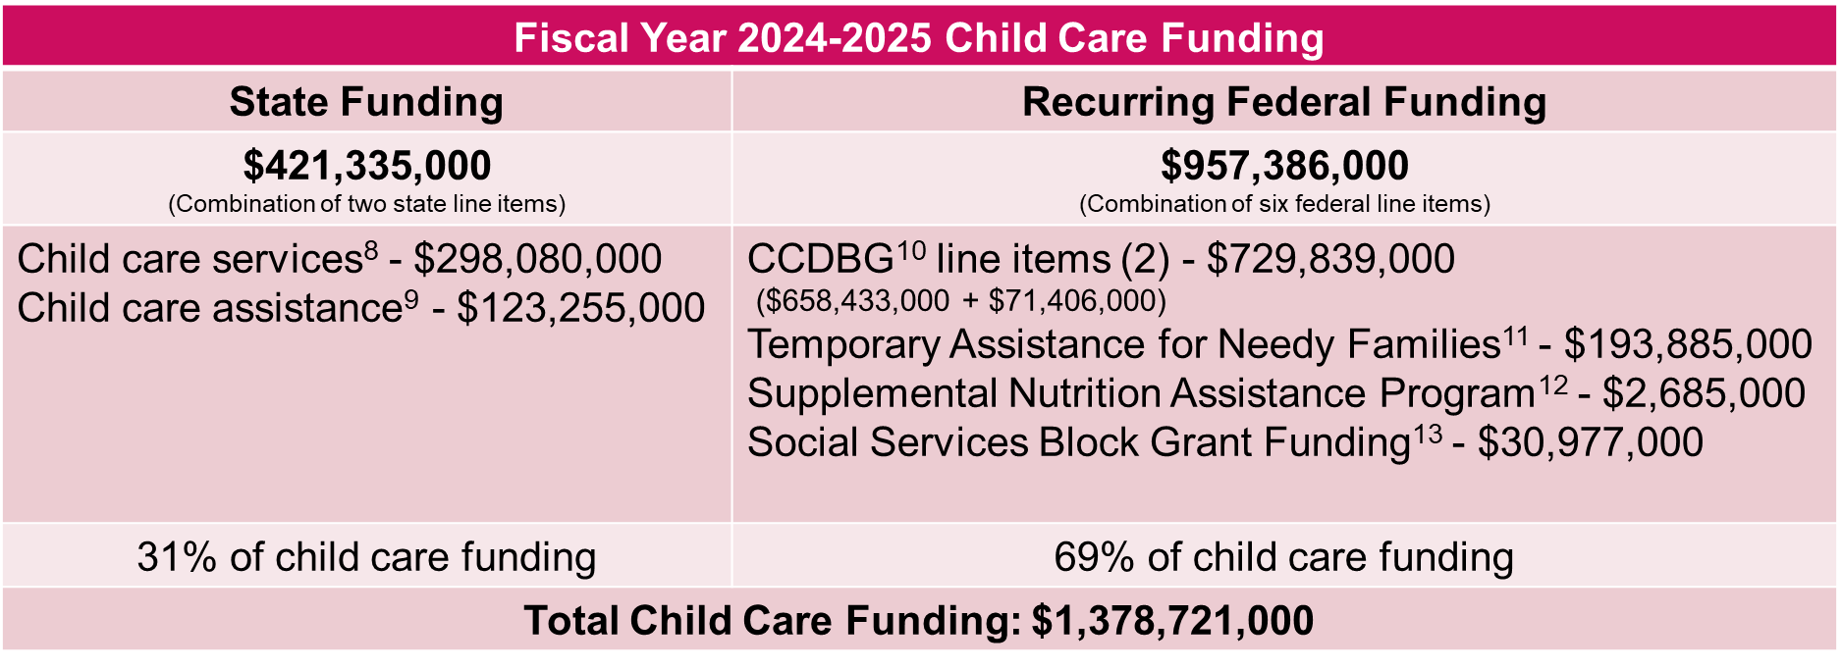
Child Care Funding in Pennsylvania
^{8, 9, 10, 11, 12, 13} https://www.legis.state.pa.us/cfdocs/legis/li/uconsCheck.cfm?yr=2024&sessInd=0&act=1A
Notes:
^{8, 9, 10, 11, 12, 13} https://www.legis.state.pa.us/cfdocs/legis/li/uconsCheck.cfm?yr=2024&sessInd=0&act=1A

Slide 20
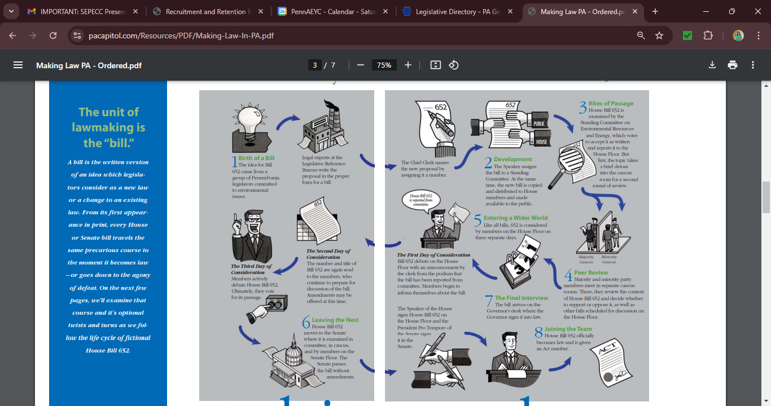
The life cycle of a House Bill in Pennsylvania
Notes:
^{8, 9, 10, 11, 12, 13} https://www.legis.state.pa.us/cfdocs/legis/li/uconsCheck.cfm?yr=2024&sessInd=0&act=1A

Slide 21
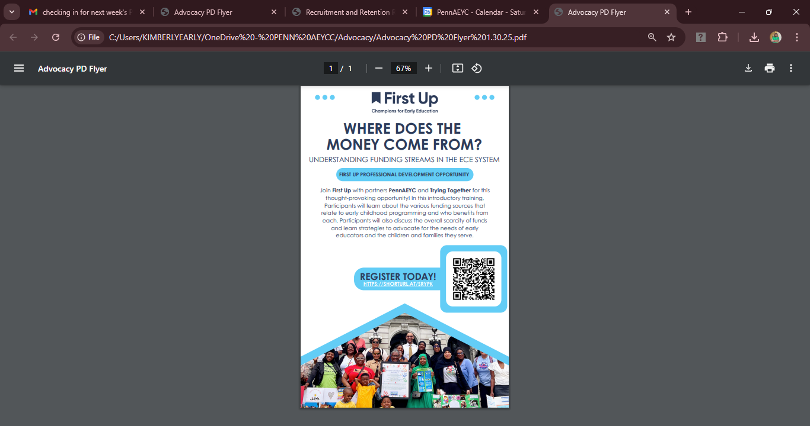

Professional development opportunity
January 30, 2025
6:30 pm – 8:00 pm
Register today!
https://shorturl.at/SrypK
Notes:
^{8, 9, 10, 11, 12, 13} https://www.legis.state.pa.us/cfdocs/legis/li/uconsCheck.cfm?yr=2024&sessInd=0&act=1A

Slide 22

Lisa Iliopoulos,
Executive Director/Owner
Little People’s Village
Provider Spotlight

Slide 23

Carolyn Green - OCDEL carolygree@pa.gov
ASIA M. SHEPPARD - DHS
ASSHEPPARD@PA.GOV
JAMILA DASHIELL - DHS
JDASHIELL@PA.GOV
Marykay Mahar- ELRC
mmahar@phmc.org
\
OCDEL, DHS
& ELRC Announcements

Slide 24

Carolyn green
Chief of staff, OCDEL
carolygreen@pa.gov

Slide 25
OCDEL Conference 2025
April 22-23, 2025
Wyndham Grand Pittsburgh Downtown
Focus on social emotional well-being; addressing behaviors staff find challenging
Open to all child care providers – prioritize teachers and directors

Slide 26
Ocdel equity Awards
The Office of Child Development and Early Learning (OCDEL) is now accepting applications for the Fourth Annual Pennsylvania Equity in Early Childhood Education Champion Awards. The award recognizes the work of the early childhood education (ECE) programs and professionals on behalf of Pennsylvania children and their families through embracing diversity and full inclusion as strengths, upholding fundamental principles of fairness and justice, and working to eliminate structural inequities that limit equitable learning opportunities.
Find more information and apply here: Equity in ECE Awards - The Pennsylvania Key

Slide 27
Certification
Quarterly Newsletter: Sign up to receive Certification eNews
Podcast: The Confluence

Slide 28

Market Rate Survey Campaign 2025
OCDEL will be asking ECE partners to assist in distributing the information around the MRS survey in spring of 2025
To understand the value of providers participating in the upcoming MRS 2025, review the MRS 2022 found here.
Notes:
Special Announcement - Email from The Pennsylvania Key
Link to regulations on DHS website - Child Care Regulations | Department of Human Services | Commonwealth of Pennsylvania

Slide 29

ASIA M. SHEPPARD - DHS
ASSHEPPARD@PA.GOV
JAMILA DASHIELL - DHS
JDASHIELL@PA.GOV

Slide 30
DHS Updates
Bureau of Certification Newsletter - January 2025
Announcement C-25-01, Maintaining Compliance with the Child Protective Services Law (CPSL) for Department of Human Services (DHS) certified child care facilities
  This announcement informs certified child care providers of the CPSL requirements for certified child care facilities in Pennsylvania and clarifies Provisional Hiring Requirements for employees hired on or after February 1, 2025. There is no change to what clearances are required for employment and volunteering.
  This replaces Announcement C-19-02 Meeting the Requirements of the Child Protective Services Law (CPSL) for Child Care facilities in its entirety.
Announcement C-24-03 Updated Health and Safety Training Part 1 and Part 2.
  This Announcement provides a new two-part Health and Safety Training that all child care providers hired on or after January 1, 2025, who have not previously completed an acceptable Health and Safety training, must complete.
  This announcement replaces Announcements C-22-02, relating to Updates to Health and Safety Training and Professional Development Requirements, and C-22-06, relating to Updated Health and Safety Pre-Service and One-Hour Training.
  The Health and Safety Training Part 1 and Part 2 will be available in Spanish.
  In the monthly Confluence Podcast, hosts Ruby Martin, Director of Bureau of Certification, and Chris Loos, Bureau of Certification Services Division Chief, take listeners on a journey to understand the complexities of OCDEL’s Bureau of Certification Services. Episode #2 – Exploring the Revised Health and Safety Trainings

Slide 31

Marykay Mahar
Senior Director,
Philadelphia Early Learning Initiatives
ELRC Region 18
mmahar@phmc.org

Slide 32
ELRC 17 Updates
ELRC 17 is hosting Parent Café Events at Child Care Providers in Montgomery County. This is a great Family Engagement Opportunity. Reach out to your Quality Coach to schedule an event at your center.
ELRC 17 next Local Leadership Council Meeting will be on Wednesday, January 29th from 1-3pm. This meeting is held in a hybrid format. All Community Partners, Stakeholders and Child Care Providers in Montgomery County are encouraged to attend. To Register: Click Here
ELRC 17 next Health & Safety Regional Taskforce Meeting will be on Wednesday, February 19th from 1-2:30pm. This meeting is held in a hybrid format. All Community Partners, and Child Care Providers in Montgomery County are encouraged to attend. To Register: Click Here
ELRC 17 Monthly Newsletter is sent via our Quality Coaches each month. Our newsletter is posted on our website: www.montcopa.org/elrc

Slide 33
ELRC 19 REMINDERS
Contact ELRC 19 for assistance or additional information
Susan Moylan named Director of ELRC 19. Susan has been with the ELRC since its inception in 2018 and with STARS in various capacities since 2007. She is incredibly honored and excited to begin this work.
ELRC Region 19 Weekly Early Education Newsletter
ELRC 19’s provider newsletter is delivered weekly to your inbox. You will find current announcements, OCDEL news, Keystone STARS and CCW updates, and information about regional services and events. To subscribe to the ELRC 19 weekly newsletter, go to our website: www.elrc19chesco.org and click on the subscription box.
ELRC 19 Provider Chit Chat
All Chester County providers are invited to join our community partners and Quality Coaches at our bi-monthly virtual Provider Chit Chat meeting! Participation is strongly recommended as important information for all Chester County childcare providers is shared! Each meeting brings a different presenter and topic. March 18th at 10 am and our topic will be Chester Counties Rapid Response Team (RRT). Information and invitations can be found in our weekly newsletter. Subscribe to our newsletter by clicking on the subscription box on our website: www.elrc19chesco.org

Slide 34
ELRC 18 REMINDERS
Contact ELRC 18 for assistance or additional information
Adele Struble new interim Family Services Manager (astruble@phmc.org)
Contact Email Reminders:
  Ongoing Family Case Needs: ELRC18Family@phmc.org
  Provider needs: ELRC18Provider@phmc.org
  New APPLICATION submissions and updates: ELRC18Intake@phmc.org
Advisory Committee Update Over 60 providers and families submitted applications to participate and selected participants were notified. Committee will offer direct feedback as clients to drive service improvement.
Newsletter Reminder: Sign up here (right side of webpage). Newsletter is bi-weekly and regularly shares ELRC updates, provider resources, and family resources. Also announces quarterly Provider Network Meeting events (next scheduled in March).

Slide 35

Special Presentation:
Zakiyyah boone
Kia Douglass
Melanie Brennan
Mary Graham
Norma Finklestein
Zaira velez
Staffing Challenges
&
Some Possible Supports

Slide 36

Community Partner Resources

Slide 37


KIDAZZLE LITERACY PUPPETRY
Talona Coleman
Heaven Sent Child Care

Slide 38




Slide 39
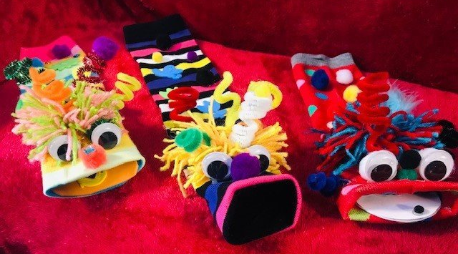



Slide 40


Alix Lauren Cozen Senior Instructor
2025 First Up Conference alix.cozen@firstup.org

Slide 41

Where & When | Participants are invited to attend a 2-day, in-person conference at The Hilton Philadelphia City Avenue on Friday, April 25th and Saturday, April 26th, 2025. This year’s conference is titled Beyond the Classroom: Inspiring Lifelong Learning and Development.

Slide 42

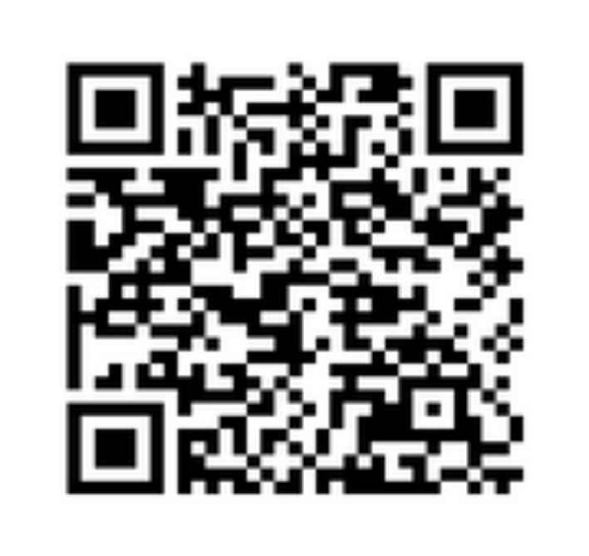
SCAN HERE TO REGISTER

Slide 43
2025 First Up Conference
Conference Growth Pathways| 1–2-hour sessions
Learning about me
Learning about my classroom
Learning about others
Learning about leadership
Learning to take action
The First Up Conference is more than professional development, it’s a chance to invest in your own growth!

Slide 44
2025 First Up Conference
Conference Intention
Think of this time as a gift—a chance to expand your perspective, deepen your skills, and spark ideas that will stay with you long after the conference is over. By focusing on your personal and professional growth, you’re not just impacting yourself—you’re creating ripples that will inspire the children, the families, your colleagues, and your community.
So, lean in. Be curious. Reflect. Connect. And know that every moment you invest in yourself today will empower you to make a greater impact tomorrow.
Let’s go beyond the classroom together!

Slide 45
2025 First Up Conference
Conference | Mentions & Extras
We will be holding a tribute to Adam Wolf from Lakeshore.
Adam passed this past Fall and Lakeshore will be giving away environmental materials to create a new classroom.
We will also be holding a space for you to build, discover and wonder in our Playroom, lots of materials to be innovative with and something you can take and bring into your classrooms on Monday!

Slide 46

Sharon Neilson or Khadijah Sabir
Email: voicesofece@gmail.com

Slide 47

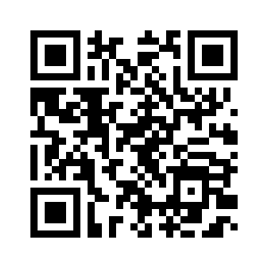
Scan the QR Code to RSVP to Join us in Solidarity on
Monday May 12, 2025.
Notes:
Here is the link to the QR Code (to put on the chat) - https://forms.gle/fkao9TpL9PZGYPG37

Slide 48


The Voice of ECE In Person Meeting- Don’t miss it!
Column A
Please register via ZOOM for this In-Person Meeting, Wednesday, February 12th

Slide 49
Thank You

Slide 50

Public Policy Partners
Kashmiera Harris
Executive Director,
Secure Future Academy, Provider Council President
Dawn Nock
Racial Equity Provider Council Coordinator
Racial Equity Early Childhood Provider Council​

Slide 51

Early Childhood Provider Council
Building on the BUILD Report
2021 Convening to learn about the ECE landscape in Philadelphia
From that report the Council was formed
50 members
5 subcommittees
One of those subcommittees was the Quality Subcommittee
We are looking for provider input on the final draft

Slide 52
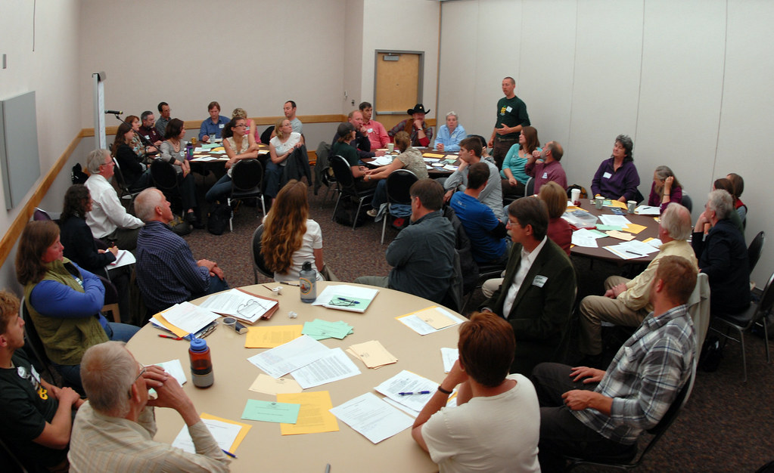


Listening Session Dates/Locations
February In-Person Listening Sessions
  Tuesday, February 18th, 5PM-6PM
  ^{Wonderspring New Market West}
  ^{(5901 Market Street)}
  Thursday, February 27th, 5PM-6PM
  ^{Bustleton Learning Center}
  ^{(6600 Bustleton Avenue)}
February Virtual (Zoom) Listening Session
Friday, February 21st, 1PM-2PM
  Scan QR code or use the Zoom link in the chat to register
Notes:
1.) You are invited to a Zoom meeting.
When: Feb 21, 2025 01:00 PM Eastern Time (US and Canada)
Register in advance for this meeting:
https://us06web.zoom.us/meeting/register/0vKCC-9OR7qrCqSo9BaJdQ
After registering, you will receive a confirmation email containing information about joining the meeting.
2. )Form to request information: https://forms.gle/wXi4ZCY3ghdcBJir6

Slide 53

Defining Quality
Drop your reply in the Chat…
What quality standard(s) in ECE programs are widely recognized and consistently applied?
Are there any quality standards that are often overlooked and undervalued?
Do you believe there needs to be clarity on how quality is measured? What needs to be clearer?
How do you explain to new teachers how quality is measured?
What essential needs or resources are required to produce quality? Why?

Slide 54

Kashmiera HaRris,
Executive Director, Secure Future Academy, Provider Council President securefutureacademy1@gmail.com
Dawn Nock, M.Ed
Provider Council Coordinator dawnn@childrenfirstpa.org

Slide 55

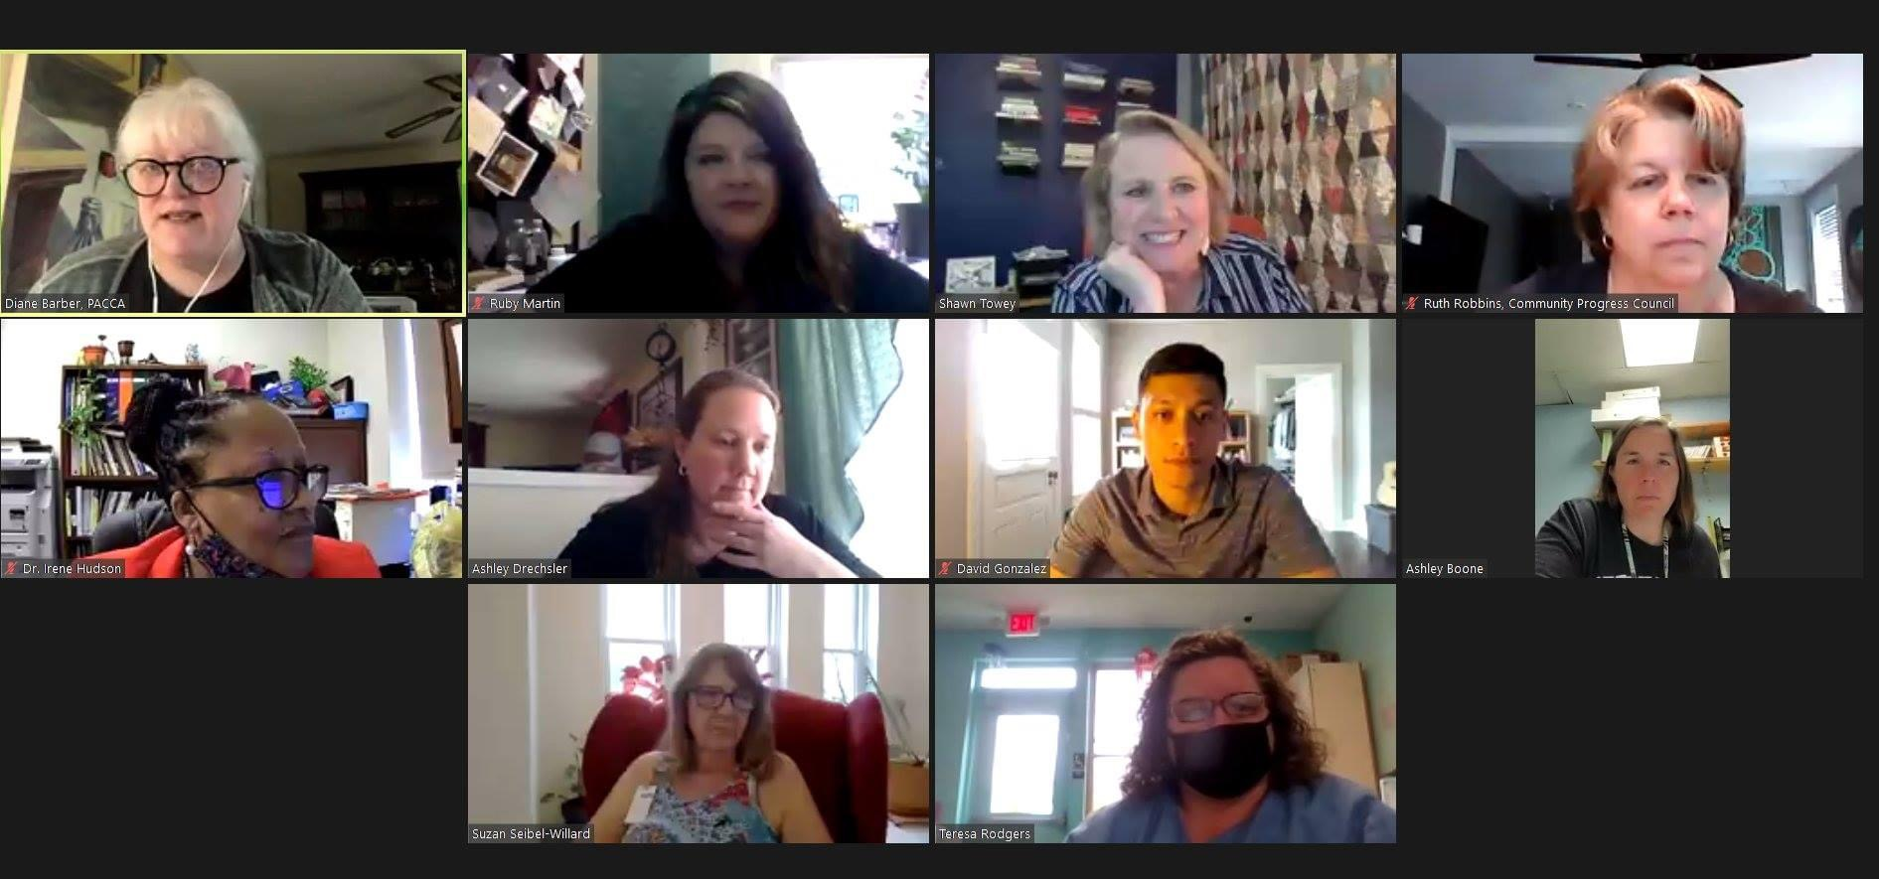
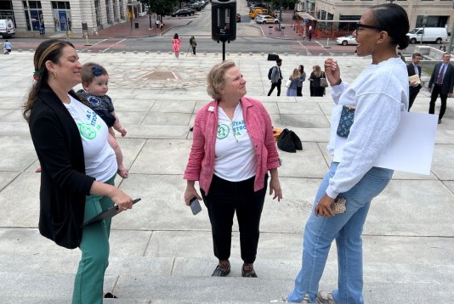
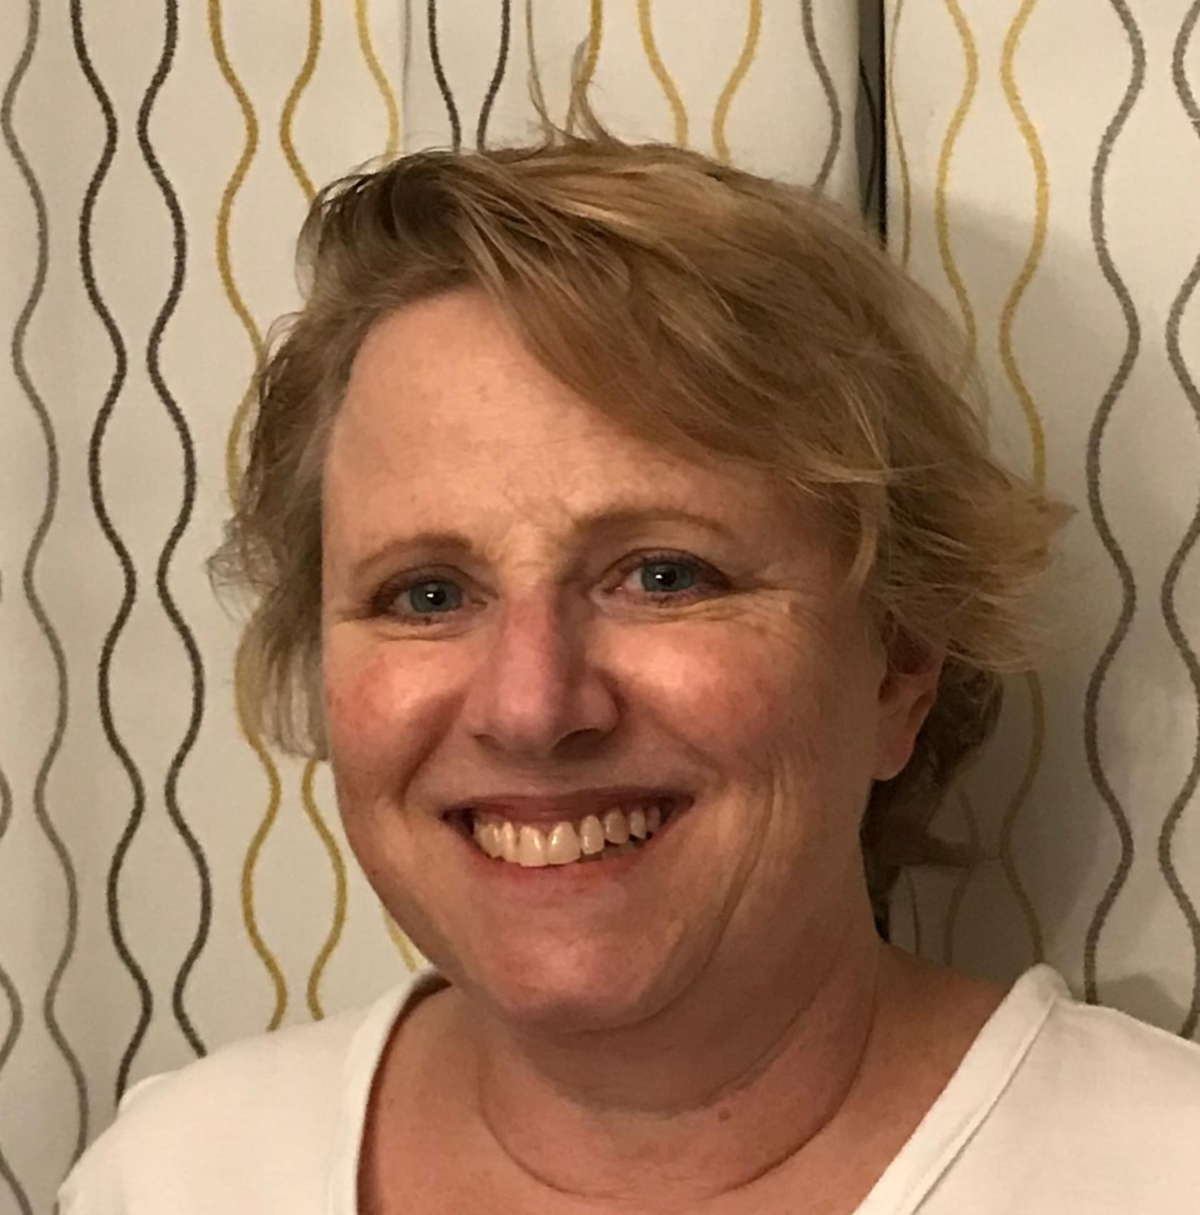
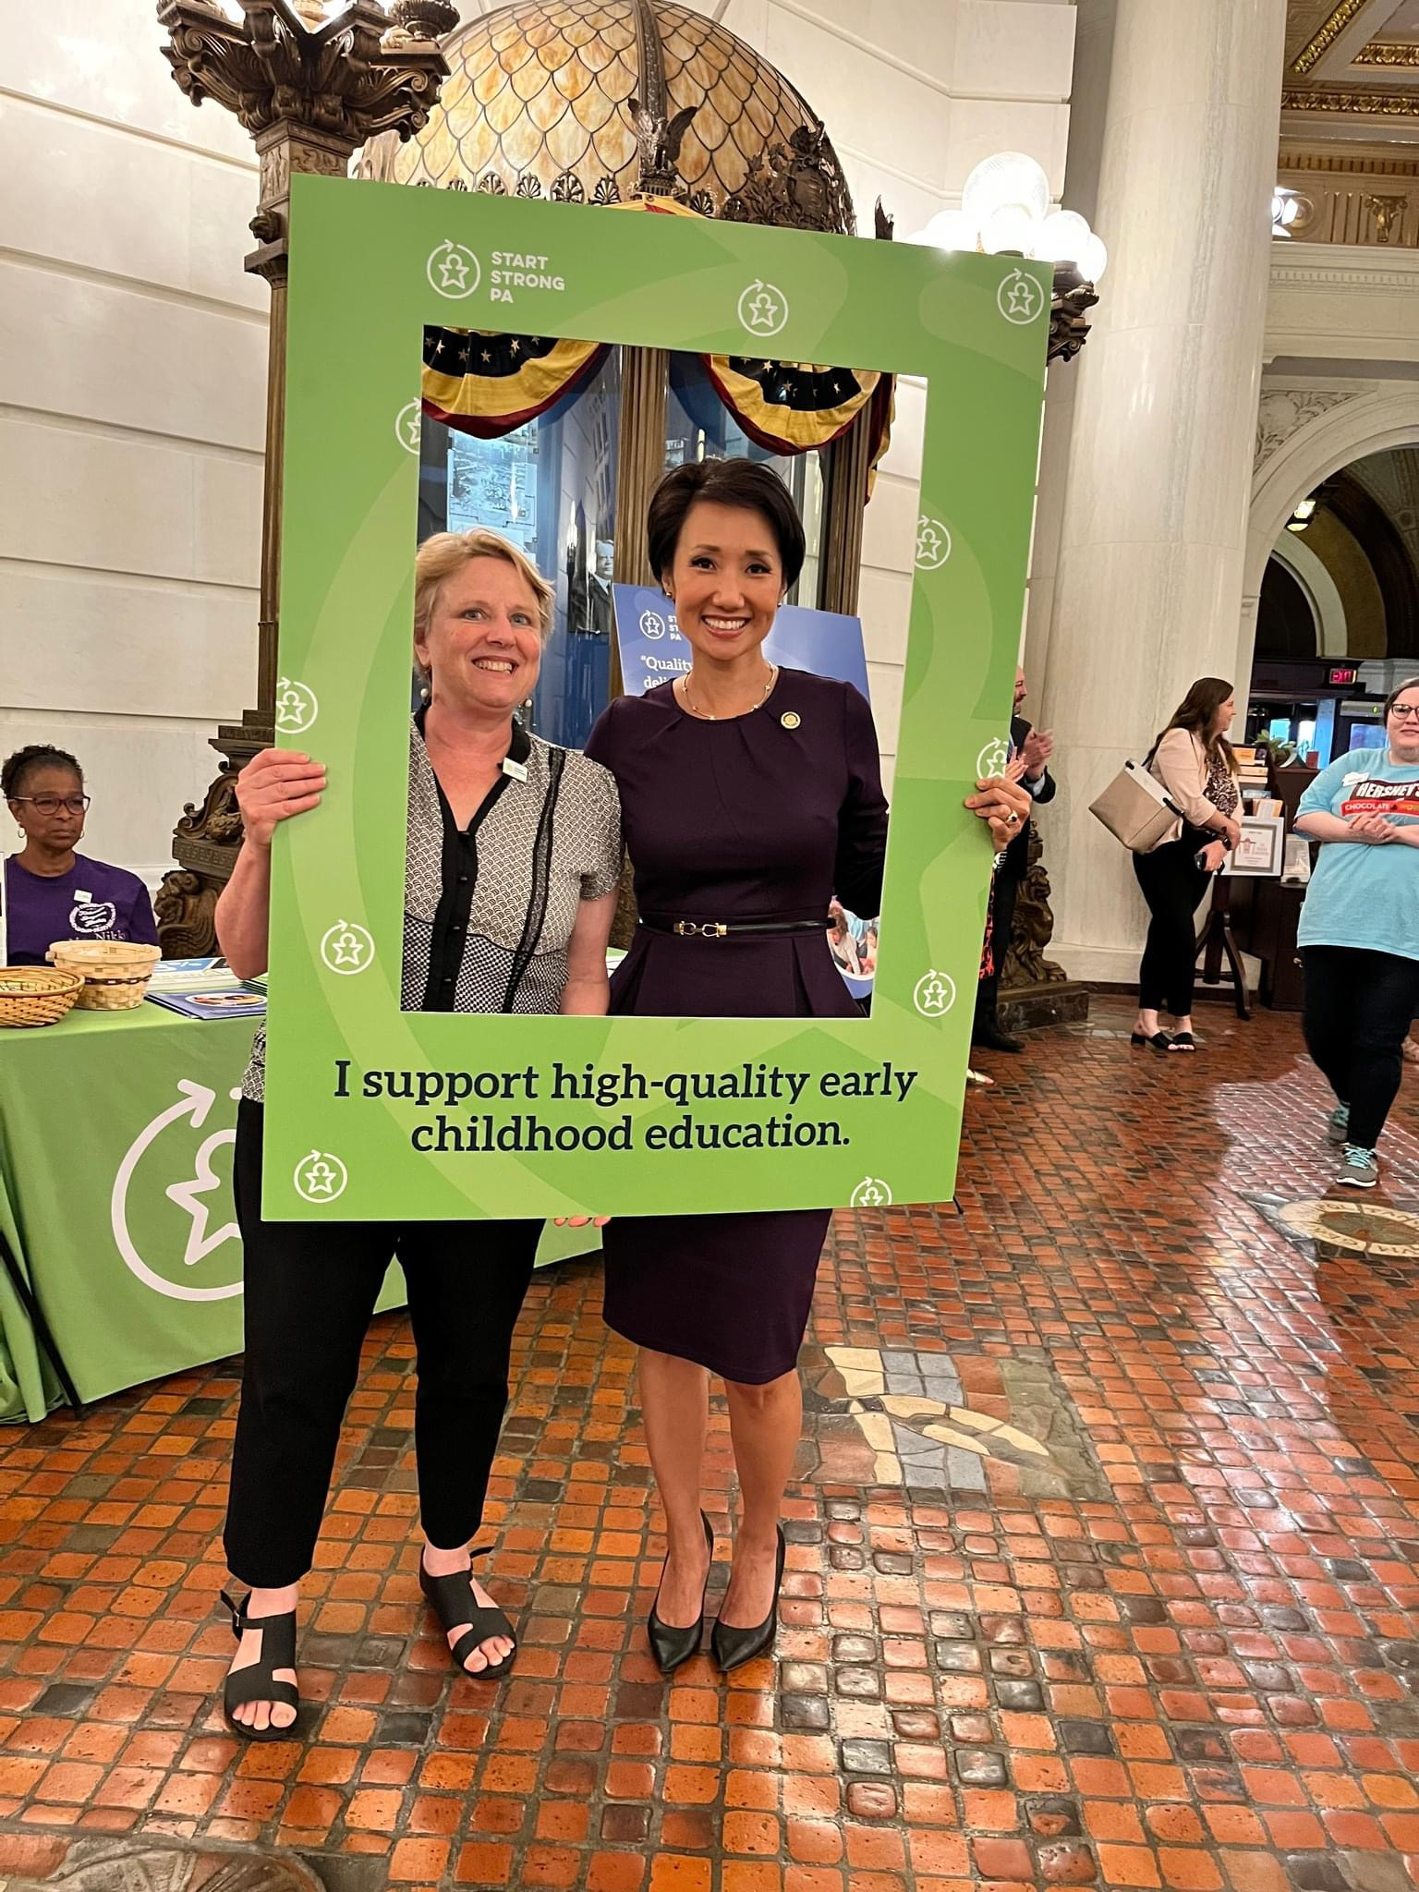
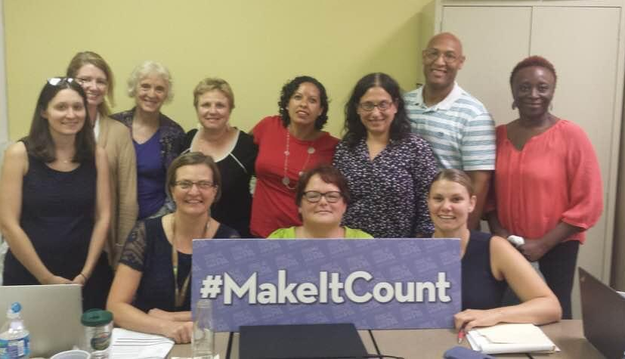
Congratulations, Shawn!

Slide 56
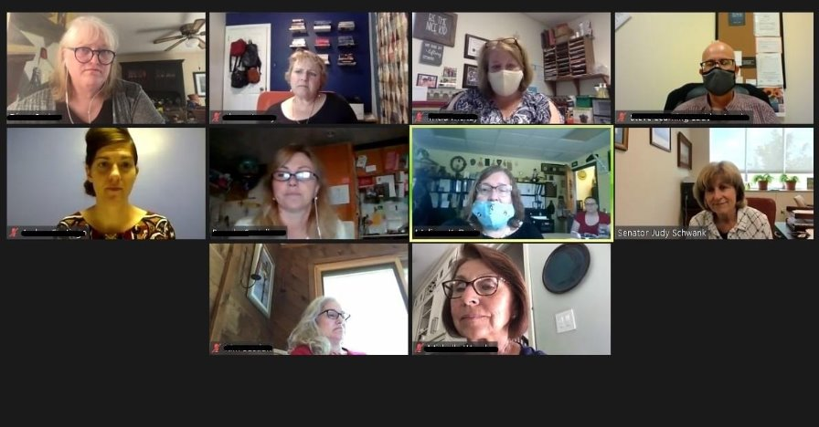
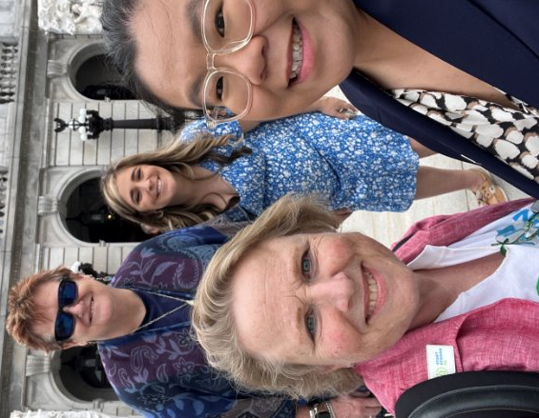
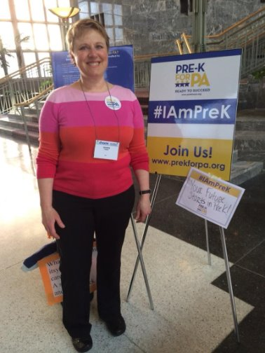

THANK YOU, SHAWN!
You will be dearly missed!
Wishing you endless joy, relaxation, and fulfillment in this exciting new chapter of your life.
Happy Retirement!

Slide 57




2025 SEPECC COMMITTEE VOLUNTEERS
Social Media Workgroup
Shar'ron Brown Carroll
Eleanor Levie
Sim Loh
Jowanna Gordon
Shawn Towey
Advisory Council
Diane Getzinger
Elizabeth Ozer
Khadijah Sabir
Maddy Malis
MaryKay Mahar
Norma Finkelstein
Pamela Haines
Advocacy Workgroup
Eleanor Levie
Jowanna Gordon
Laverne Cheeseboro
Lisa Iliopoulos
Monique Roye
Nicole Dyson
Nicole Fetherman
Shawn Towey
Shineal Hunter
Sim Loh
Shirlee Howe
Velda Wilson
Steering Committee
Zakiyyah Boone(Co-Chair)
Jackie Groetsch
Melody Connell
Kia Douglass
Latonta Godboldt
Laverne Cheeseboro
Mary Graham
Melanie Brennan
Minette Taylor
Sharon McClafferty
Shineal Hunter
https://docs.google.com/forms/d/e/1FAIpQLSeoLbBfst0Q7zxrLBv8rH66p3akSjXG75_QPFOQpeum6zUCKg/viewform
Jan. 2025

Slide 58


30-Second Exit Survey:
https://forms.gle/JX2UUjBUaUcbkguSA
Upcoming Meetings: (12:30 – 2:30pm)
  February 25
  March 25
Meeting Registration Links on First Up/SEPECC Webpage: https://www.firstup.org/sepecc/
MEETING
WRAP UP
Notes:
First Up/SEPECC Webpage: https://www.firstup.org/sepecc/

